Slide 1
Introduction to Economics
What is Economics?
By Hussain Ali Harri
After studying this chapter, you will be able to:
Define economics and distinguish between micro and macro economics.
Explain the three big questions of microeconomics
Explain the three big questions of macroeconomics.
Explain the ideas that define the economic way of thinking.
Explain how economists go about their work as social scientists.
Page/ I . M . Philosophy
theims2020 official
hussain-ali
hussainalik749
theimsofficial1
theims media
theims.media@gmail.com
+923429767995
theimsmedi.com.pk

Slide 2
Objectives
After studying this chapter, you will be able to:
Define economics and distinguish between micro and macro economics
Explain the three big questions of microeconomics
Explain the three big questions of macroeconomics
Explain the ideas that define the economic way of thinking
Explain how economists go about their work as social scientists
theimsmedi.com.pk
theims.media@gmail.com

Slide 3
Choice, Change, Challenge and Opportunity
Economics, the science of choice, has much to say about the change, challenge and opportunity that we face today
Technological change, terrorism and recession provide a landscape that is rich with problems to be tackled and choices to be understood
Your economics course helps you understand the powerful forces that shape and change our world
theims.media@gmail.com

Slide 4
Definition of Economics
Scarcity
All economic questions arise because we are unable to satisfy our wants – because we face scarcity
Economics is the social science that studies the choices that individuals, businesses, governments and societies make as they cope with scarcity
theims.media@gmail.com

Slide 5
Definition of Economics
The IMS
YouTube Channel
Microeconomics
Microeconomics is the study pf choices made by individuals and businesses and the influence of government on those choices
Macroeconomics
Macroeconomics is the study of the effects on the national and global economy of the choices that individuals, businesses and governments make
theims.media@gmail.com

Slide 6
Theme of Microeconomics
Economics is all about limits
Limited incomes of consumers
Limited budgets
Limited technical know-how
Limited number of working hours
Economics teaches us to make the most of these limits which we call optimum allocation of resources
theims.media@gmail.com

Slide 7
Core of Economics
The IMS
YouTube Channel
The Economizing Problem
“ Want is a growing giant whom the coat of Have was never large enough to cover”
Ralph Waldo Emerson
theims.media@gmail.com

Slide 8
Three Big Microeconomic Questions
The IMS
YouTube Channel
Microeconomics seeks to understand what determines:
What goods and services are produced
How goods and services are produced
For whom goods and services are produced
Goods and services are the objects that people value and produce to satisfy wants
theims.media@gmail.com

Slide 9
Three Big Microeconomic Questions
The IMS
YouTube Channel
How are Goods and Services produced?
Factors of production are the resources that businesses use to produce goods and services
They are grouped into four categories:
Land
Labor
Capital
Entrepreneurship
theims.media@gmail.com

Slide 10
Three Big Microeconomic Questions
The “gifts of nature” that we use to produce goods and services are land
The work time and effort that people devote to producing goods and services is labor
The quality of labor depends on human capital, which is the knowledge and skill that people obtain from education, on-the-job training and work experience

Slide 11
Three Big Microeconomic Questions
The tools, instruments, machines, buildings and other constructions that are used to produce goods and services are capital
The human resource that organize land, labor and capital is entrepreneurship

Slide 12
Three Big Microeconomic Questions
The IMS
YouTube Channel
For Whom are Goods and Services Produced?
Who gets the goods and services depends on the incomes that people earn
Land earns rent
Labor earns wages
Capital earns interest
Entrepreneurship earns profit

Slide 13
Three Big Macroeconomic Questions
The IMS
YouTube Channel
Macroeconomics focuses on three big questions:
What determines the standard of living?
What determines the cost of living?
Why does our economy fluctuate?

Slide 14
Three Big Macroeconomic Questions
The IMS
YouTube Channel
What determines the Standard of Living?
The standard of living is the level of consumption that people enjoy on the average and is measured by average income per person

Slide 15
Three Big Macroeconomic Questions
What determines the Cost of Living?
The cost of living is the amount of money it takes to buy the goods and services that a typical family consumes
The cost of living in the United States is the number of dollars it takes to buy goods and services that a typical family consumes

Slide 16
Three Big Macroeconomic Questions
The IMS
YouTube Channel
A rising cost of living is called inflation
A falling cost of living is called deflation
Inflations brings a shrinking value of the dollar and deflation brings a rising value of the dollar
Macroeconomics seeks to explain the forces that determine the cost of living and the inflation or deflation rates

Slide 17
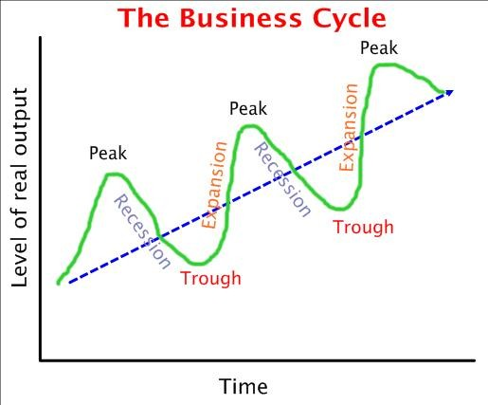
Three Big Macroeconomic Questions

Slide 18
Three Big Macroeconomic Questions
The IMS
YouTube Channel
Why does our economy fluctuate?
Economists remain unsure about the sources of economic fluctuations and about the actions that might be taken to smooth the economy
But in your study of macroeconomics, you will learn what economists have discovered about economic fluctuations

Slide 19
Economics: A Social Science
The IMS
YouTube Channel
Economics distinguishes between two types of statements:
What is – positive statements
What ought to be – Normative statements
A positive statement can be tested by checking it against facts
A normative statement cannot be tested

Slide 20
Economics: A Social Science
The IMS
YouTube Channel
The task of economic science is to discover positive statements that are consistent with what we observe in the world and that enable us to understand how economic world works
This task is large and breaks into three steps:
Observation and measurement
Model building
Testing models

Slide 21
Economics: A Social Science
The IMS
YouTube Channel
Observation and Measurement
Economists observe and measure economic activity keeping track of such things as:
Quantities of resources
Wages and works hours
Prices and quantities of goods and services produced
Taxes and government spending
Quantities of good and services bought from and sold to other countries

Slide 22
Economics: A Social Science
The IMS
YouTube Channel
Model Building
An economic model is a description of some aspect of the economic world that includes only those features of the world that are needed for the purpose at hand

Slide 23
Economics: A Social Science
Testing Models
An economic theory is a generalization that summarizes what we think we understand about the economic choices that people make and the performance of industries and entire economies
A theory is a bridge between a model and reality. It is a proposition about which model works

Slide 24
Thanks
theimsmedia.com.pk
theims.media@gmail.com
Subscribe our YouTube Channel
The IMS
&
Like our Facebook Page
I.M.Philosophy
WhatsApp:- +923429767995

